Slide 1
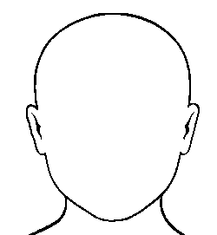
CANDIDATE
PERSONAS
Personal Details
Interests
FOCUS
What’s your most important persona? Start by focusing on them. It’s better to form a strong connection with your key target group rather than spread yourself thinly by creating a ton of weak profiles.
Working Style
Roles & Experience
Goals
Hooks
A user persona is an all-encompassing description of a group of people you wish to target. Personas normally consist of the needs, motivations, challenges goals, likely used channels and observed behaviour patterns of your customer or candidate.
Having a persona allows you to better understand who you’re communicating with and what they’re likely to respond to which increases the possibility of a positive engagement.
You don’t have to create personas for every person you ever engage with, but the general rule of thumb here is that if they are important, they get a persona.
Skills
Likely Objections
Traits
Personality
Consumed Media

